Slide 1

Statistical Machine Learning
4
First steps into Data Science

Slide 2
4.1
Statistical Machine Learning.

Slide 3
Statistical Machine Learning
Statistical Machine Learning emphasizes on the statistical properties of datasets
This is most commonly used where predictions are paramount
Stock Market forecasting
Medical Diagnosis
4.1. Statistical Machine Learning. Read more: Intro to statistical ML

Slide 4
Understanding the framework
So far we have understood how to handle the data
Now we use the dataset to map out a problem to solve
Example: Given data (X,Y) where X is input and Y is output, what function can be a good predictor of F(X)=Y ?
This is where ML models come into play
4.1. Statistical Machine Learning.

Slide 5
What roles to models play
Models play the role of the function that is “fitted” onto the dataset
The model takes in data X and predicts an output Y
We evaluate the model with loss functions
Lets learn a few of those models today
4.1. Statistical Machine Learning.

Slide 6
4.2
Linear Regression.

Slide 7
What is Linear Regression?
Linear Regression is one of the simplest and most widely used statistical technique
It’s goal is to model a relationship between a single dependent variable with one or more multiple independent variable
4.2. Linear Regression.

Slide 8
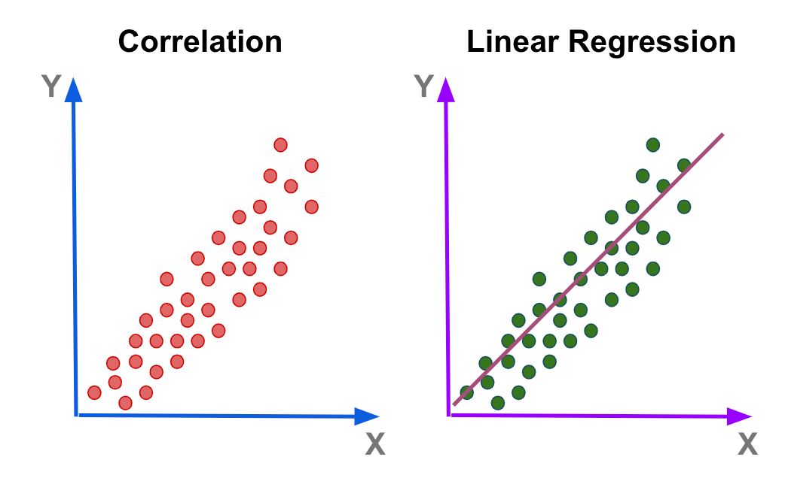
4.2. Statistical Machine Learning.
4.2. Linear Regression.

Slide 9
When to use Linear Regression
Nature of the Relationship: When the relationship between the independent and dependent variable is believed to be linear.
Continuous Output: When predicting values that are continuous (e.g., house prices, temperatures).
Interpretability: When it's important to understand the influence of each feature on the output. Linear regression provides coefficients for each feature which indicate their relative importance.
4.2. Statistical Machine Learning.
4.2. Linear Regression.

Slide 10
Things to note
Linear Regression works best when there is a linear relationship between the predictors and the response
Regression tasks predict a value based on input data
Works best when:
Residuals are normally distributed
Residuals have constant variance
4.2. Statistical Machine Learning.
4.2. Linear Regression.

Slide 11
Python Implementation
from sklearn.linear_model import LogisticRegression
from sklearn.datasets import load_breast_cancer
# Load a sample dataset
X, y = load_breast_cancer(return_X_y=True)
X_train, X_test, y_train, y_test = train_test_split(X, y, test_size=0.2)
# Train the model
clf = LogisticRegression(max_iter=5000)
clf.fit(X_train, y_train)
# Make predictions on test data
predictions = clf.predict(X_test)
4.2. Statistical Machine Learning.
4.2. Linear Regression.

Slide 12
Cost Function in Linear Regression
Mean Square Error (MSE): Average squared difference between actual and predicted values
Adjust model parameters to minimize MSE
4.2. Linear Regression.

Slide 13
4.3
Logistic Regression.

Slide 14
What is Logistic Regression?
Linear Regression is good for predicting continuous value but not much else
Logistic Regression predicts the probability of occurrence of an event by fitting data to a logistic curve
4.3. Logistic Regression.

Slide 15
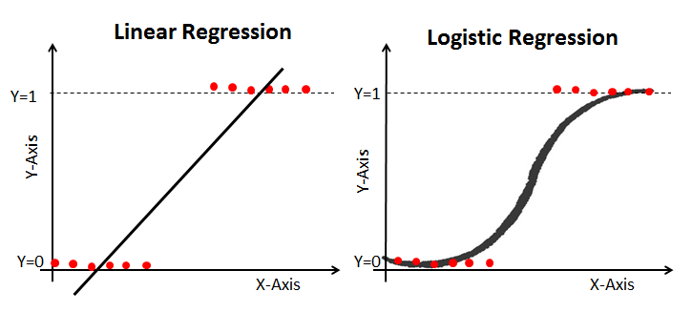
4.2. Statistical Machine Learning.
4.3. Logistic Regression.

Slide 16
When to use Logistic Regression
Binary Outcome: When the dependent variable is binary (e.g., spam or not spam, churn or not churn).
Probabilistic Results: When you need to know the probability of your output. Logistic regression doesn’t just give a binary outcome, it gives the probability of that outcome.
Feature Importance: Similar to linear regression, logistic regression provides coefficients that can help in understanding the influence of features.
4.2. Statistical Machine Learning.
4.3. Logistic Regression.

Slide 17
Python Implementation
from sklearn.linear_model import LogisticRegression
from sklearn.datasets import load_breast_cancer
# Load a sample dataset
X, y = load_breast_cancer(return_X_y=True)
X_train, X_test, y_train, y_test = train_test_split(X, y, test_size=0.2)
# Train the model
clf = LogisticRegression(max_iter=5000)
clf.fit(X_train, y_train)
# Make predictions on test data
predictions = clf.predict(X_test)
4.2. Statistical Machine Learning.
4.3. Logistic Regression.

Slide 18
Cost Function in Logistic Regression
Log-Loss: Measure the performance of a classification model whose output probability value is between 0 and 1
4.3. Logistic Regression.

Slide 19
4.4
Decision Trees.

Slide 20
What are Decision Trees?
Decision Trees split data into subsets
This process is repeated recursively
Results in a tree-like model of decisions
4.4. Decision Trees.

Slide 21
Components of Decision Trees
Root Node: Represents the entire dataset, gets divided
Decision Node: When a sub-node splits into further sub-nodes
Leaf Node: Nodes that contain the decision to be taken
4.4. Decision Trees.

Slide 22
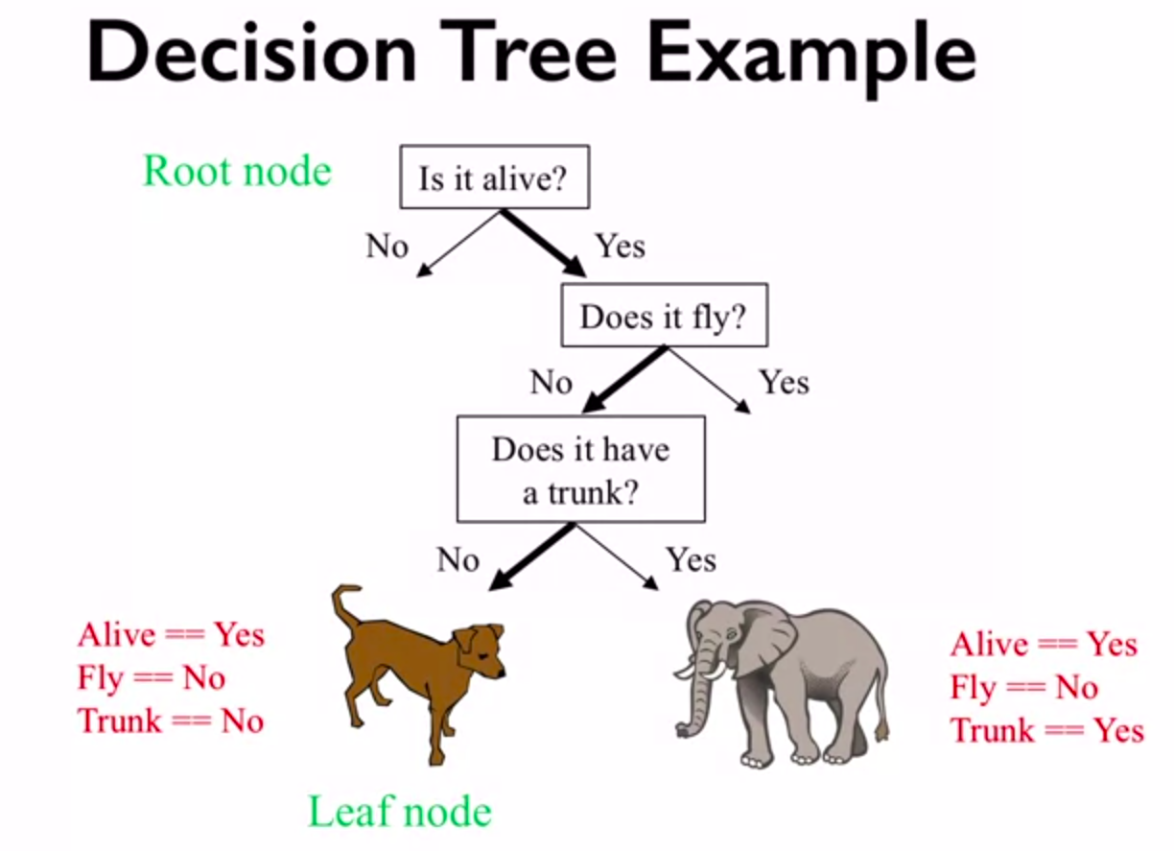
4.2. Statistical Machine Learning.
4.4. Decision Trees

Slide 23
Splitting Criteria
Impurity: Measures how often a randomly chosen element would be incorrectly classified.
Entropy: Measures randomness or unpredictability in the dataset.
Information Gain: The entropy of the original dataset minus the weighted average entropy of the split datasets.
4.4. Decision Trees

Slide 24
Overfitting Issue in Decision Trees
Overfitting: When a model captures noise in the training data and performs poorly on new, unseen data.
Complex Trees: Trees that are too deep can capture noise.
Pruning: Process of reducing the size of a tree by turning some branch nodes into leaf nodes to reduce complexity.
4.4. Decision Trees

Slide 25
When to use Decision Trees
Non-linear Relationships: Decision trees can capture nonlinear relationships between features and the target variable
Interpretability: They are easy to visualize and understand, making them great for deriving insights and rules
Categorical Input Features: They handle categorical variables easily
Feature Interactions: Decision trees can inherently capture interactions between features
4.2. Statistical Machine Learning.
4.4. Decision Trees

Slide 26
Python Implementation
from sklearn.tree import DecisionTreeClassifier
from sklearn.datasets import load_iris
# Load a sample dataset
X, y = load_iris(return_X_y=True)
X_train, X_test, y_train, y_test = train_test_split(X, y, test_size=0.2)
# Train the model
tree = DecisionTreeClassifier()
tree.fit(X_train, y_train)
# Make predictions on test data
predictions = tree.predict(X_test)
4.2. Statistical Machine Learning.
4.4. Decision Trees

Slide 27
4.5
Random Forest.

Slide 28
What are Random Forests?
Random Forests are an ensemble of decision trees
Each tree in a Random Forest is trained on a random subset of data
Bagging: A feature of Random Forests that aggregates decision of individual trees and reduces variance
4.5. Random Forests.

Slide 29
Advantages of Random Forests
Reduction in Overfitting: Diversity among trees reduces chances of overfitting.
Feature Importance: Ability to rank features based on their importance in making predictions.
Handling Missing Values: Can handle missing data without explicit imputation.
Generalization: Often generalizes better to new data than individual trees.
4.5. Random Forests.

Slide 30
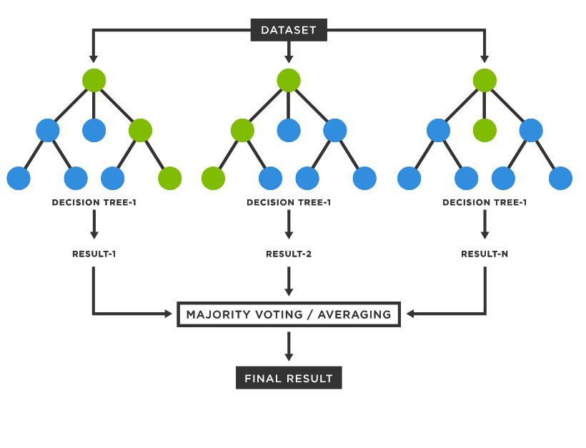
4.2. Statistical Machine Learning.
4.5. Random Forests.

Slide 31
Disadvantages of Random Forests
Interpretability: Harder to interpret than a single decision tree.
Computation: Requires more computational resources.
Forest Size: Need to choose the number of trees (more isn't always better).
4.5. Random Forests.

Slide 32
When to use Random Forests
High Accuracy: When performance is a primary concern. Random forests generally yield better accuracy than individual decision trees.
Feature Importance: Random forests can rank features based on their importance in making accurate predictions.
Handling Overfitting: Random Forests, through bagging, tend to reduce the overfitting that can be observed with individual decision trees.
Handling Large Data: They can handle datasets with a higher dimensionality and can manage missing values.
Non-linear Data: They can capture non-linear feature interactions.
4.2. Statistical Machine Learning.
4.5. Random Forests.

Slide 33
Python Implementation
from sklearn.ensemble import RandomForestClassifier
from sklearn.datasets import load_digits
# Load a sample dataset
X, y = load_digits(return_X_y=True)
X_train, X_test, y_train, y_test = train_test_split(X, y, test_size=0.2)
# Train the model
forest = RandomForestClassifier(n_estimators=100)
forest.fit(X_train, y_train)
# Make predictions on test data
predictions = forest.predict(X_test)
4.2. Statistical Machine Learning.
4.5. Random Forests.

Slide 34
4.6
Support Vector Machines (SVM).

Slide 35
What are Support Vector Machines (SVM)?
SVM is a supervised ML algorithm which can be used for both classification or regression
It performs classification by finding the hyperplane that best divides dataset into classes
Hyperplane: a generalized plane in different dimensions
4.6. Support Vector Machines.

Slide 36
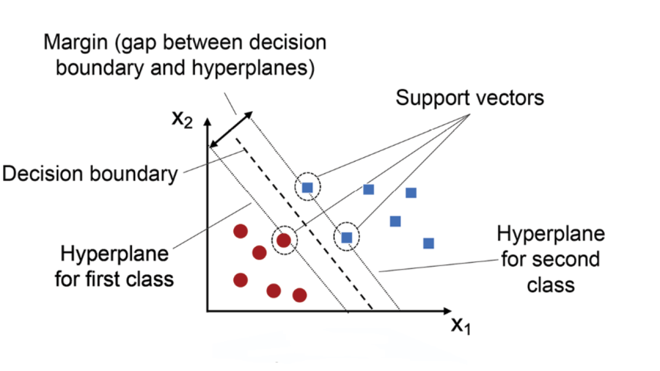
4.2. Statistical Machine Learning.
4.6. Support Vector Machines.

Slide 37
Ideal Situations
Text Classification problems
When there is a need of margin separation
Complex datasets where linear separation is not obvious
4.2. Statistical Machine Learning.
4.6. Support Vector Machines.

Slide 38
Drawbacks
Inefficient on large datasets
Sensitive to noise
Requires fine-tuning using parameters such as the kernel
4.2. Statistical Machine Learning.
4.6. Support Vector Machines.

Slide 39
When to avoid
Large datasets
Datasets with a lot of noise
When there is no clear margin or separation
4.2. Statistical Machine Learning.
4.6. Support Vector Machines.

Slide 40
Python Implementation
from sklearn.preprocessing import StandardScaler
from sklearn.svm import SVC
# Feature scaling
scaler = StandardScaler()
X_train = scaler.fit_transform(X_train)
X_test = scaler.transform(X_test)
# Training SVM
svm = SVC(kernel='linear', C=1)
svm.fit(X_train, y_train)
# Prediction
y_pred = svm.predict(X_test)
4.2. Statistical Machine Learning.
4.6. Support Vector Machines.

Slide 41
4.7
K-Nearest Neighbors (KNN).

Slide 42
What is KNN?
KNN is a non-parametric, lazy learning algorithm
It assumes the similarity between the new data input with the available data
Then assigns the new data into the category that is most similar to the available data categories
4.7. K-Nearest Neighbours.

Slide 43
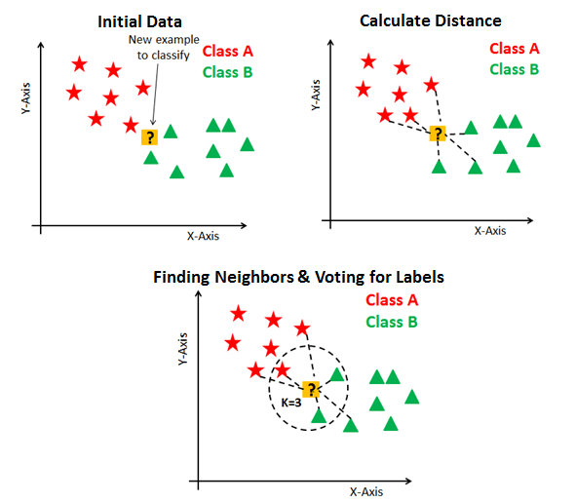
4.2. Statistical Machine Learning.
4.7. K-Nearest Neighbours.

Slide 44
Ideal Situations
When the dataset is relatively small
The data has little noise
The data has decision boundaries are very irregular
4.7. K-Nearest Neighbours.

Slide 45
Drawbacks
KNNs becomes significantly slower as the number of examples grows
It is sensitive to irrelevant or redundant features as all features contribute to the similarity
4.7. K-Nearest Neighbours.

Slide 46
When to avoid
When the dataset is relatively large
The data has high number of dimensions
Dataset has a ton of noise
4.7. K-Nearest Neighbours.

Slide 47
Python Implementation
from sklearn.neighbors import KNeighborsClassifier
# Train/test split remains the same as the previous code
# Training KNN
knn = KNeighborsClassifier(n_neighbors=3)
knn.fit(X_train, y_train)
# Prediction
y_pred = knn.predict(X_test)
# Print accuracy
print("KNN Accuracy:", sum(y_test == y_pred) / len(y_test))
4.2. Statistical Machine Learning.
4.7. K-Nearest Neighbours.

Slide 48
4.8
Gradient Boosting Algorithms.

Slide 49
What are Gradient Boosting Algorithms?
Gradient Boosting is a boosting algorithm that combines several weak learners into strong learners
It is an ensemble method
Initialization: Begins with a simple model
Residuals: It builds a sequence of trees where each new tree corrects the errors of its predecessors
4.8. Gradient Boosting Algorithm.

Slide 50
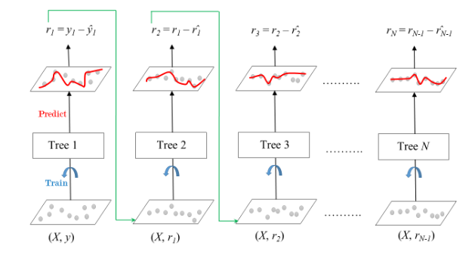
Working of Gradient Boosting Algorithms
4.2. Statistical Machine Learning.
4.8. Gradient Boosting Algorithm.

Slide 51
Ideal Situations
When there is an unbalanced dataset
When model performance is the primary concern
4.8. Gradient Boosting Algorithm.

Slide 52
Drawbacks
Can overfit on noisy data
Requires careful tuning of parameters
Longer training time as trees are built sequentially
4.8. Gradient Boosting Algorithm.

Slide 53
When to avoid
When training time is a constraint
Simple tasks where simple models can suffice
4.8. Gradient Boosting Algorithm.

Slide 54
Python Implementation
from sklearn.ensemble import GradientBoostingClassifier
# Train/test split remains the same as the previous code
# Training Gradient Boosting Classifier
gb = GradientBoostingClassifier(n_estimators=100, learning_rate=1.0, max_depth=1, random_state=42)
gb.fit(X_train, y_train)
# Prediction
y_pred = gb.predict(X_test)
# Print accuracy
print("Gradient Boosting Accuracy:", sum(y_test == y_pred) / len(y_test))
4.2. Statistical Machine Learning.
4.8. Gradient Boosting Algorithm.

Slide 55
Somethings to note
In practice, model selection often requires evaluating multiple models on the data and comparing their performance using some evaluation metric (e.g., RMSE for regression, accuracy/precision/recall for classification).
It's also essential to consider the domain-specific context, as practical considerations might dictate which model to choose even if it's not the absolute best performer.
4.2. Statistical Machine Learning.
P.S.

Slide 56
END.

